Slide 1

Limiting Reactions

Slide 2
See origi al nearpod for quiz questions to add in future
https://docs.google.com/document/d/17UBQ5IykPk9Msw-5cyy9_xYNL1nuyejoFl04jVJaBa0/edit?pli=1

Slide 3
Discuss briefly with your group
What does it mean (not in science-ese just in regular life) if something is LIMITING?

Slide 4

Overview
Limiting Problems sometimes seem complex but they really only require ONE extra step in which you decide which of two numbers is bigger. THAT’S EASY :)
Part of what makes limiting problems seem complex is that the problem typically has at least two parts and sometimes three or four. However, you simply need to recognize the different parts and divide them up to go through the problem solving map for each part.
If you can complete the map to solve problems, several times, and determine which of two numbers is bigger, then limiting is no problem!
Click for Audio. Watch for other Audio as you go

Slide 5
THE LIMITING PROBLEM
Anytime items need to be mixed in the correct proportion to each other, you may have the situation where you have too little of one ingredient to use up what is available of the other ingredients.
This means the amount available for this one ingredient LIMITS how much product you can produce.
Imagine you want to make as many sandwiches as possible. Each sandwich needs two slices of bread and one slice of meat. If you have 10 slices of bread and 8 slices of meat, you can only make FIVE sandwiches before you run out of bread. The bread amount LIMITS how many sandwiched you can make.
You will have extra meat (8 is more than the 5 you can use). In chemistry terms, we say “the meat is in excess and the bread is limiting”.

Slide 6
Let’s try it with a Chemical Reaction
If you watched the extended video for full map stoichiometry problems, you will have already seen this example worked through but we are going to modify it to a limiting problem.
ORIGINAL mass to mass problem: How many grams of hydrogen are needed to react completely with 50g of nitrogen?
N₂ + 3H₂ -> 2NH₃
Changing ONE thing creates a limiting problem:
NOW A LIMITING: If you have 12 grams of hydrogen, how much will be left over after reacting with 50g of nitrogen?

Slide 7
Discuss
1. Describe in your own words what was different about the original compared to the "limiting" version of the ammonia problem?
2. Describe a possible strategy (NO calculations, just 'Step 1' etc) for answering the limiting problem. Identify the differences from solving a regular mass to mass problem.

Slide 8
NEW FIRST STEP
This is really THE SAME first step as always except instead of the given being clearly given, you have two quantities as possible givens and you need to choose or use whichever the question indicates.
IMPORTANT: You set aside (IGNORE) the other quantities given in the question until you have completed the map.
You will compare to these “set aside” quantities after solving the first problem.
If the question does not indicate which is the limiting or which is the excess reactant, JUST CHOOSE ONE RANDOMLY. Remember you cannot compare masses to determine which is limiting. You can only compare at the Heart (the mole to mole comparison)

Slide 9
NEW FIRST STEP
OUR PROBLEM: If you have 12 grams of hydrogen, how much will be left over after reacting with 50g of nitrogen?
This clearly indicates the hydrogen is in excess. Therefore
Set aside (IGNORE) the 12 g of hydrogen information.
start the map using 50 g of nitrogen as the given
solve with hydrogen in the required position.
You can review the full map solution on the next slide and {optionally} review the video of solving this part of the problem.

Slide 10
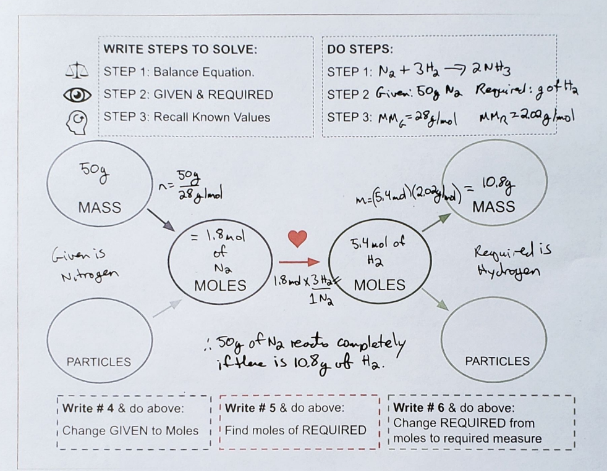
Insert PDF & Video
UPload PDF of ammonia mass to mass to nearpod

Slide 11
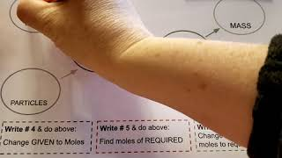
Reactant 1 to Reactant 2: Determine the limiting reactant
UPload PDF of ammonia mass to mass to from nitrogen to quantitiy of ammonia nearpod

Slide 12
At end
Do a WHAT IF which was in excess or limiting is NOT indicated.
Do EXACT same problem but without indication (how much ammonia can be made from…)
YOu use H and solve (insert map image). And compare (big >) label limiting and excess and put on map correctly.
To solve for amounts of product(s) that is produced, you MUST have the limitint reagent in the “given” position.

Slide 13
Compare to “set aside” quantity and answer the
question
Now you know:
50 g of N₂ will require 10.8g of H₂ to fully react.
NEW STEP FOR LIMITING!! WHICH NUMBER IS BIGGER:
The question: If you have 12 grams of hydrogen, how much will be left over after reacting with 50g of nitrogen?
12 g > than 10.8g.
So, the hydrogen is clearly in excess and the 50g of nitrogen will be fully reacted.

Slide 14
QUIZ
1. What is the final step and answer to the problem?
A. LEFTOVER H₂ = 12g - 10.8g = 1.2 g
B. LEFTOVER H₂ = 10.8g - 12g = -1.2 g
C. LEFTOVER H₂ = 50g - 10.8g = 40.2 g
D. There is no leftove H₂
Click for the answer
Answer: A

Slide 15
Compare to “set aside” quantity and answer the
question
What does it mean?
12 g > than 10.8g
This means the quantity of nitrogen available LIMITS the amount of ammonia you can make. If you had MORE than 50g of ammonia it would be able to react and form ammonia with the 1.2 g of hydrogen that is currently in excess.

Slide 16
Limiting and excess quiz - get off quizzizz, easy to copy
See questions on https://docs.google.com/document/d/17UBQ5IykPk9Msw-5cyy9_xYNL1nuyejoFl04jVJaBa0/edit?pli=1

Slide 17
HOW MUCH PRODUCT IS MADE
MORE ROUNDS OF MASS TO MASS PROBLEM SOLVING:
The second “complication” of limiting problems is they require multiple rounds of problem solving.
This is NO MORE DIFFICULT than doing multiple problems. You simply have to reuse the data from one step to the next.
Many problems will require you to determine how much product is made. For this, the LIMITING reactant must be in the Given position, with the desired Product in the Required position. See image on next page and following video if desired.

Slide 18
Solving for the product
You can solve for the amount of multiple products. You simply have to repeat the following steps for EACH product. Note that you can REUSE your calculations of the Given substance (which is your limiting reactant) each time.
1: Use your limiting reactant as the Given
2. Use one product the question asks you to solve for as the Required.
3. Solve the problem, following the Map steps.
NOTE: the majority of limiting problems are Mass to Mass but they can follow any route on the map.
See the next two slides for the Map image & video from our problem.

Slide 19
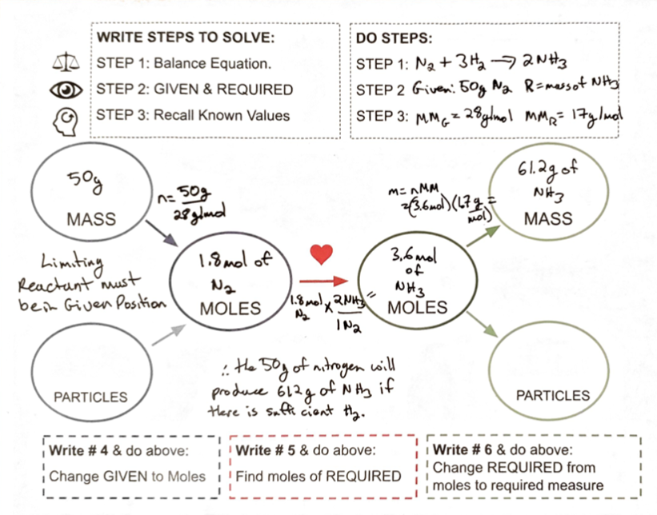
Put in map image & video

Slide 20
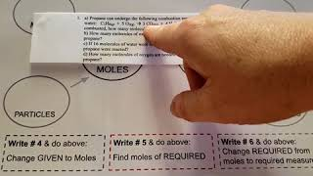
Solve for Ammonia Produced
text

Slide 21
Our Example
Reminder of question: If you have 12 grams of hydrogen, reacting with 50g of nitrogen, how much ammonia will be produced?
N₂ + 3H₂ -> 2NH₃
Use the 50 g of nitrogen as given because it is the limiting reactant, and use ammonia as the required on the stoichiometry map.See the next two slides for the Map image of the solution & video walk through {optional}.
Final answer: The 50 g of nitrogen is the limiting reactant and it will produce 61.2g of ammonia.
NOTE: this makes sense as the ammonia should weigh ~ 50g + 10.8g for the nitrogen plus hydrogen. It is not exact due to rounding required in calculations.

Slide 22
BOTTOM LINES
1. Choose either of the reactant quantities as your first “Given”. If the question indicates which is limiting and which is excess, use the limiting as the Given.
2. Solve and, if you didn’t already know, Determine the limiting reactant by comparing the quantity of the calculated reactant to what was provided in the question. See next few images for help on this.
3. To determine the quantity of products, make sure the limiting reactant is your GIVEN and put one product at a time as the Required and solve using the Stoichiometry map.
4. Remember to clearly track and label your work so you know what all your numbers are!

Slide 23
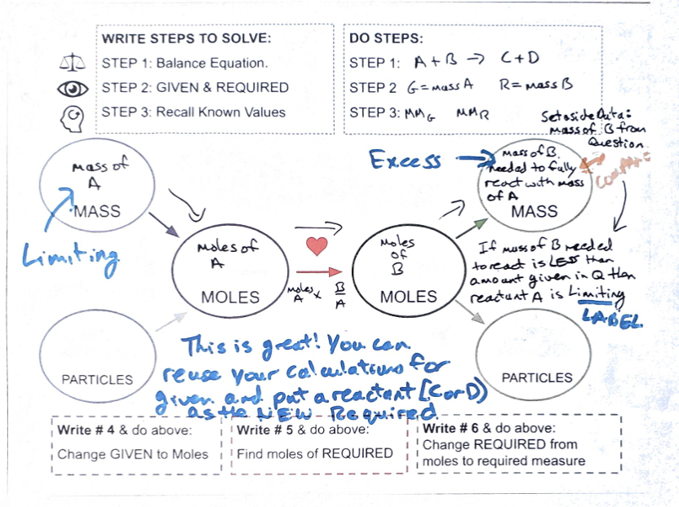
Put in images of A+B-> C+D

Slide 24
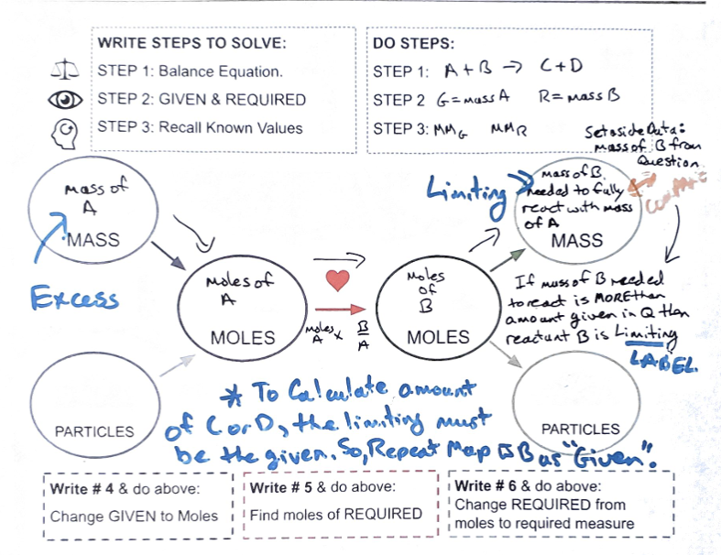
Blank Slide
text

Slide 25
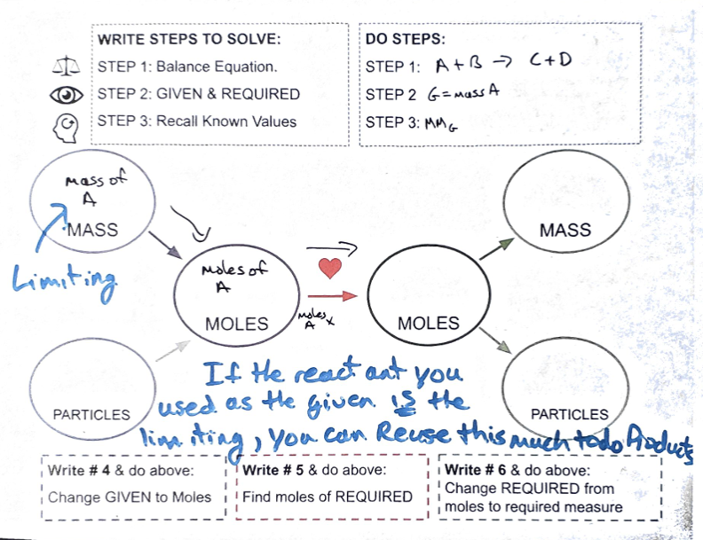
Blank Slide
text

Slide 26
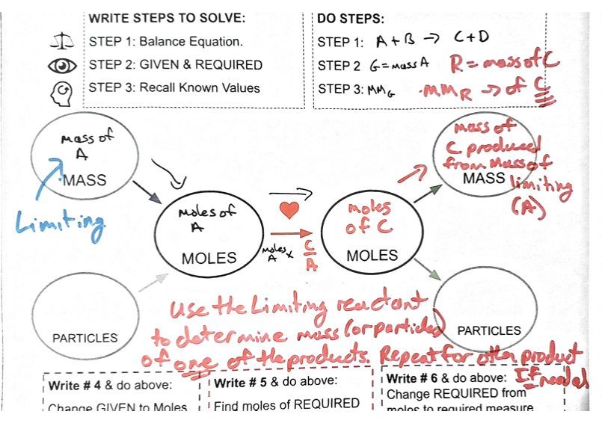
Blank Slide
text

Slide 27
Variations on Limiting problems
Listen to the audio for tips on solving these!!
Leave this for future (eg ones with one reactant with a mass and one with number of molecules)
Also there was a quiz on nearpod I can do on Quia and put here.

Slide 28
THANK
YOU!!
All slides beyond this are optional or not in use currently.

Slide 29
Phet simulation to practice? And as evaluation

Slide 30
TEMPLATE to NEARPD

Slide 31
TEMPLATE to NEARPD

Slide 32
Image wit ONLY Limiting reactant and Desired Product written on it.

Slide 33
COMPARE TO FIND LIMITING
- insert a picture of map solved for reference -

Slide 34
Details in questions you can ignore (for now)
During this unit, you can ignore the state subscripts, for example indicating gas _{(g)} or aqueous_{(aq)}, in the equation and focus the other information you need to solve the problem.
Ignore extraneous information that may be written in the problem and look for the information you are given. There should be at least two given quantities and a required product amount. Then, its your job to pick ONE of the given quantities to work with originally, using the other given quantity for the “which number is bigger” comparison.
Have fun solving the puzzle of limiting reactants 😁

Slide 35
{OPTIONAL} - Review the Mass to Mass Solving Video

Slide 36
OPTIONAL
IF the concept of how one reactant limits the amount of product you can make, leaving excess of the other reactants is still not quite making sense, you can try the simulation on the next slide.
EXPLORING THIS SIMULATION WITH SANDWICH MAKING IS OPTIONAL

Slide 37
May not do yield in this presentation but don’t forget it!
Just use preexisting edpuzzle & notes I have prob.

Slide 38
Can insert Phet in Nearpod by inserting the Webpage

Slide 39
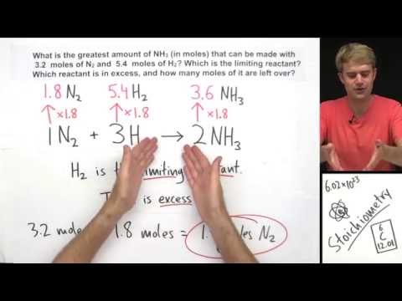
Add in optional as it makes sense to some minds.

Slide 40
